Slide 1

Hands-on NLP Project Emotion Recognition
Md. Naim Hassan Saykat
Aloïs Vincent
Marija Brkic

Slide 2
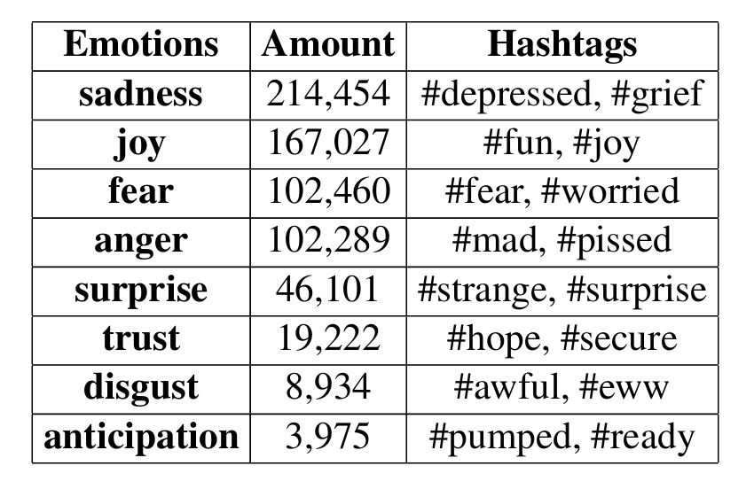
Dataset: CARER (dair-ai/emotion)
Dataset from tweets
Labeled based on hashtags
sadness, joy, love, anger, fear, surprise

Slide 3
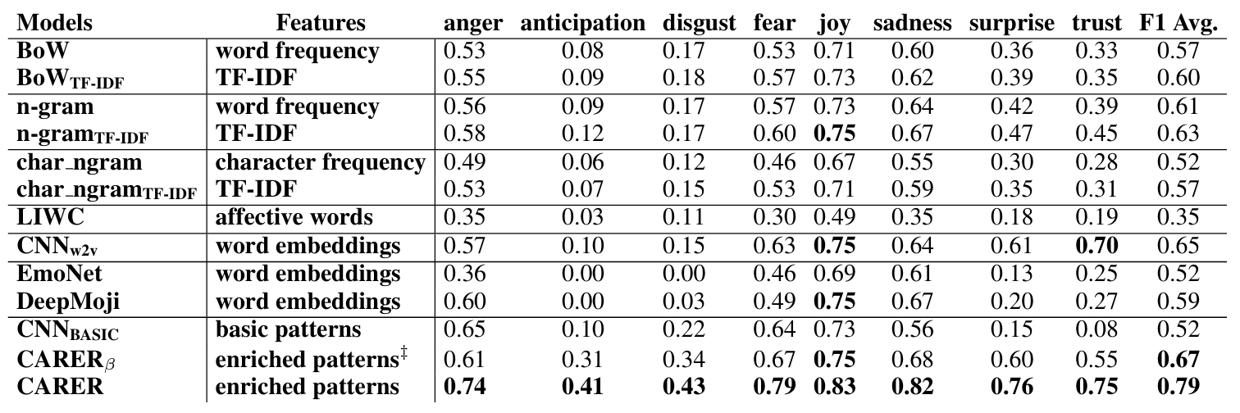
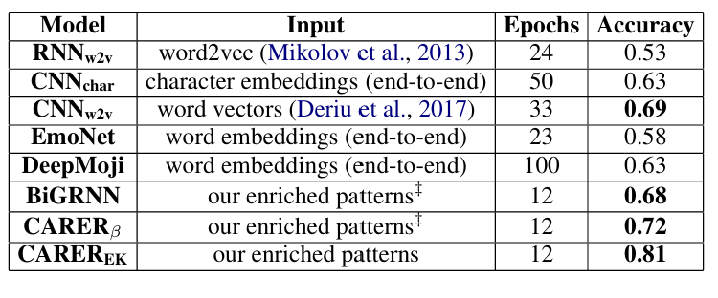
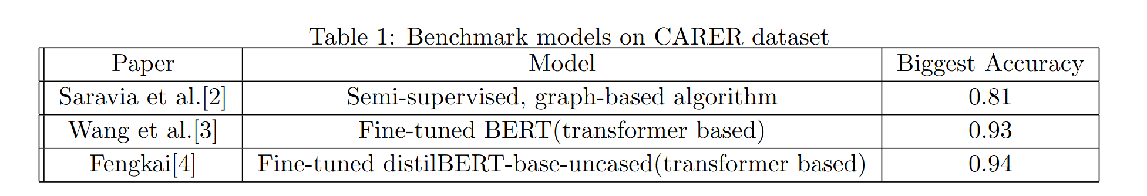
Benchmark Models

Slide 4
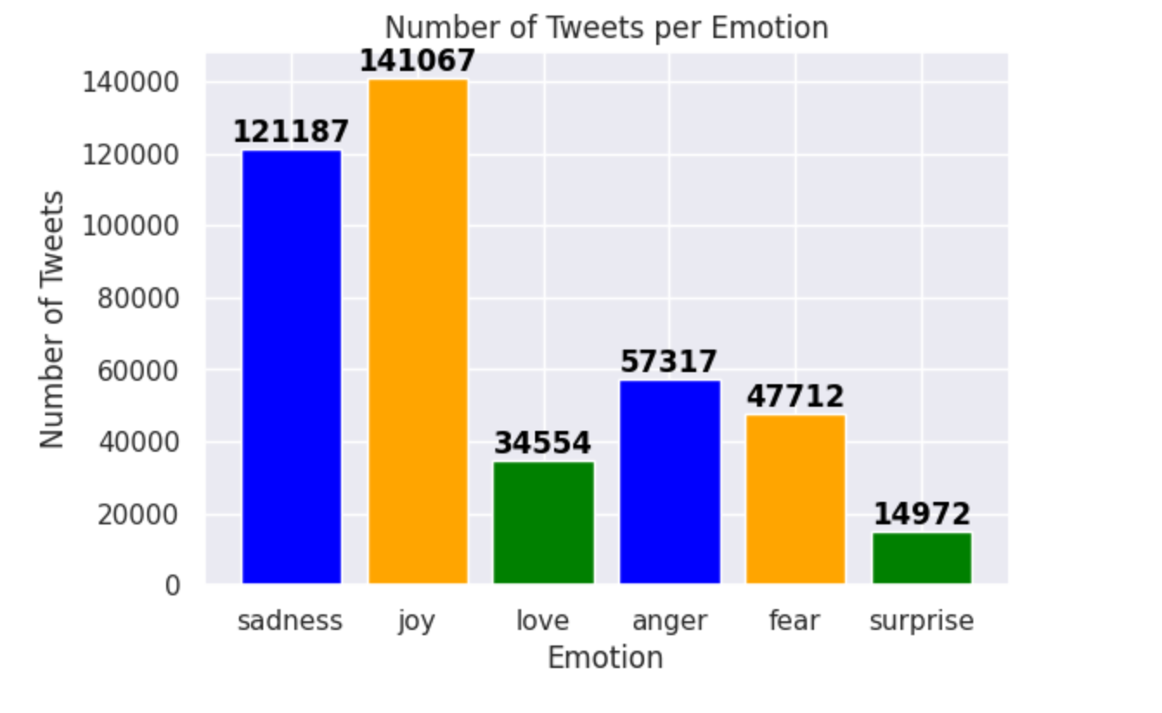
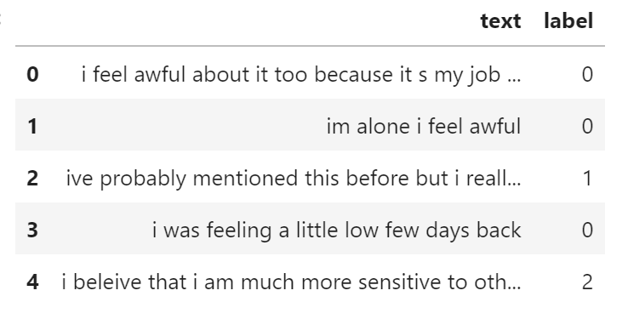
Data analyzing, preprocessing and feature extraction
Unbalanced classes
416809 tweets

Slide 5
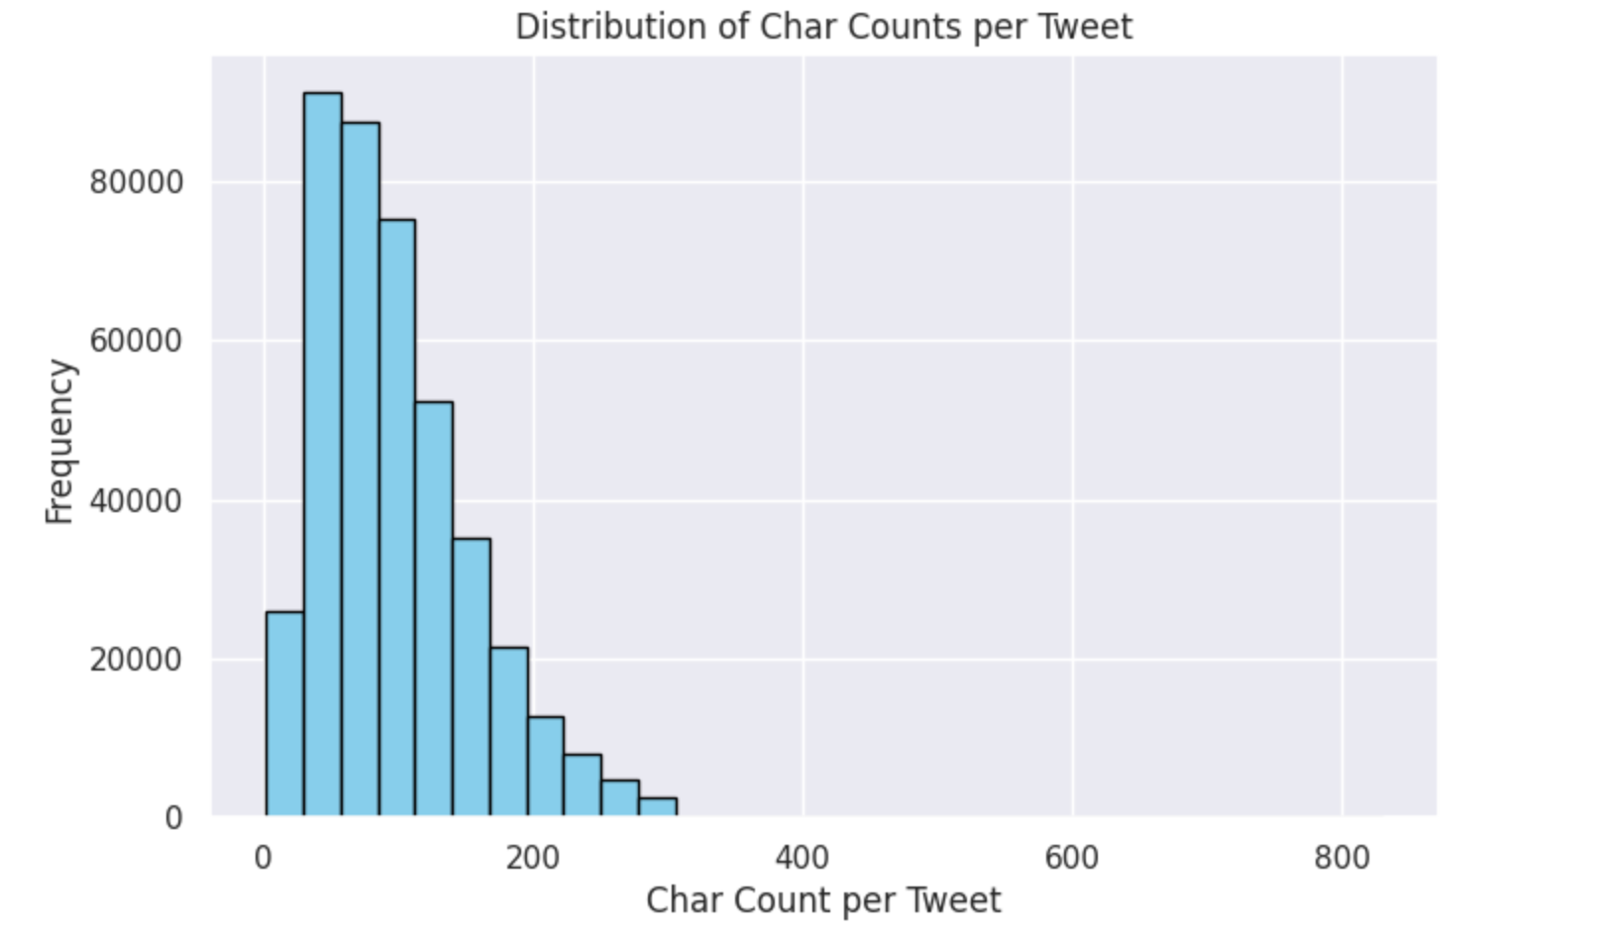
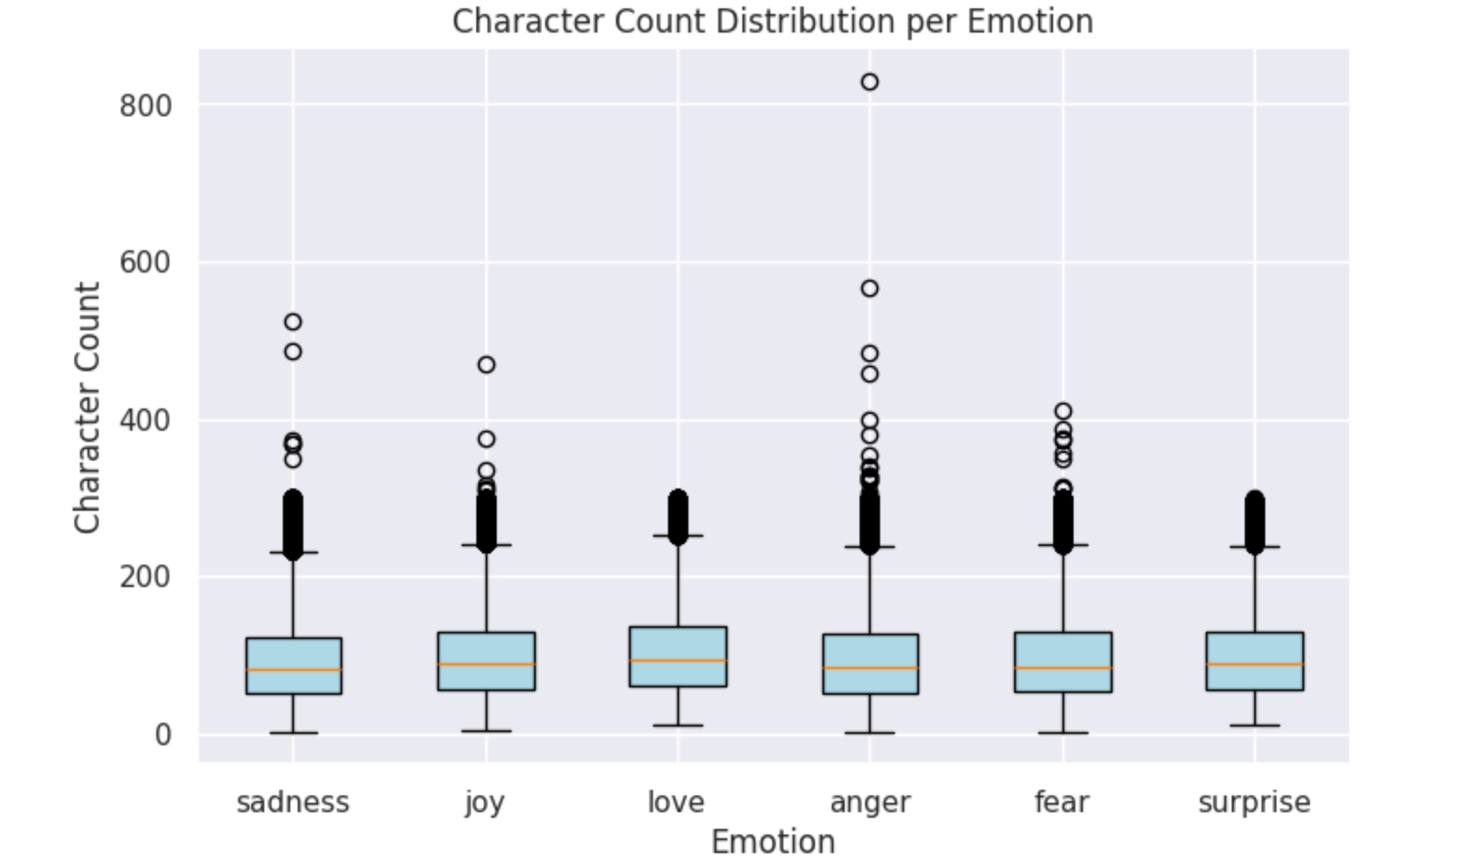
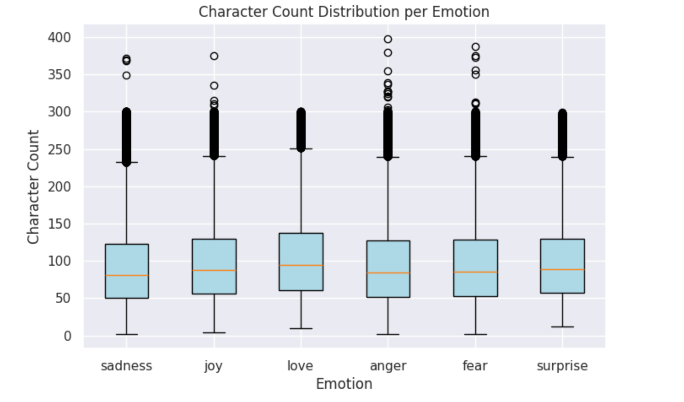
Data analyzing, preprocessing and feature extraction

Slide 6
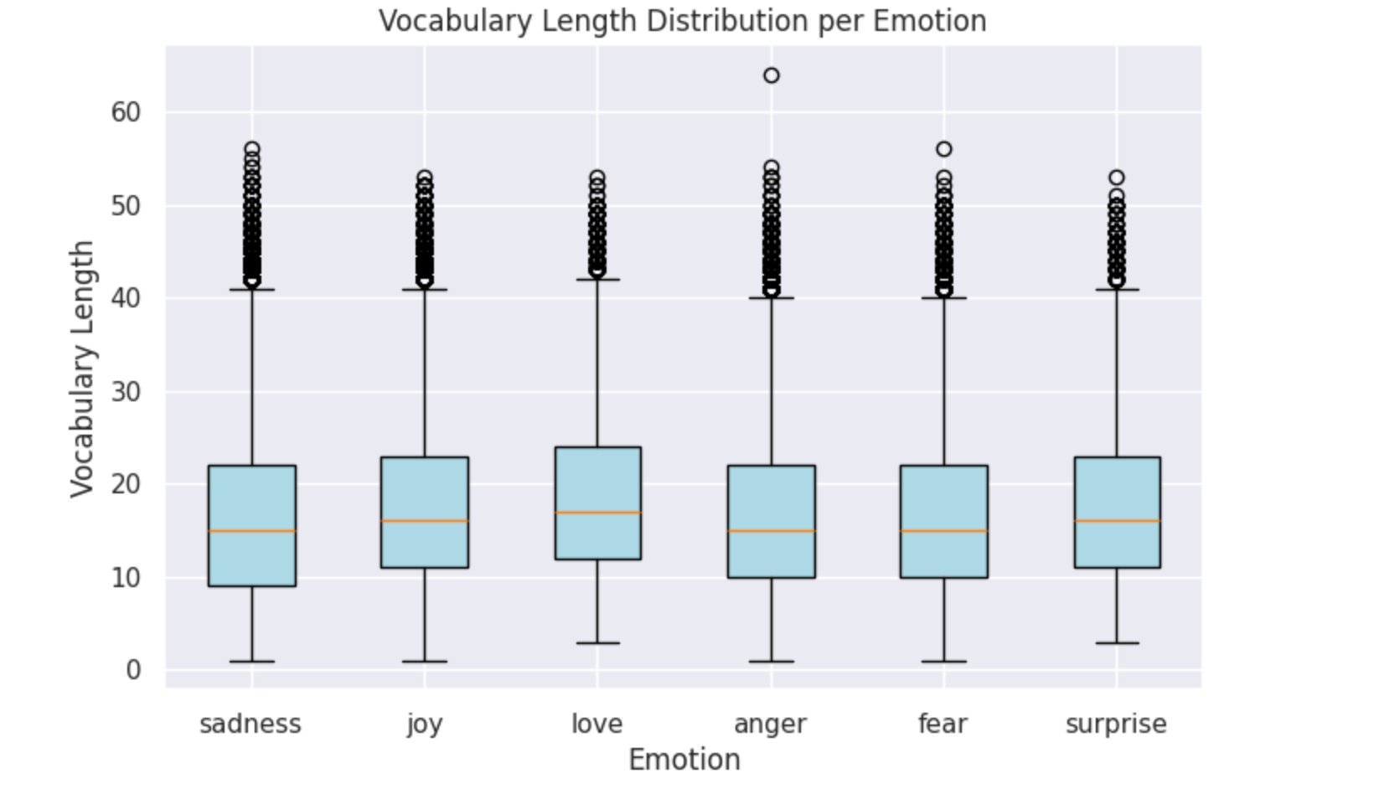
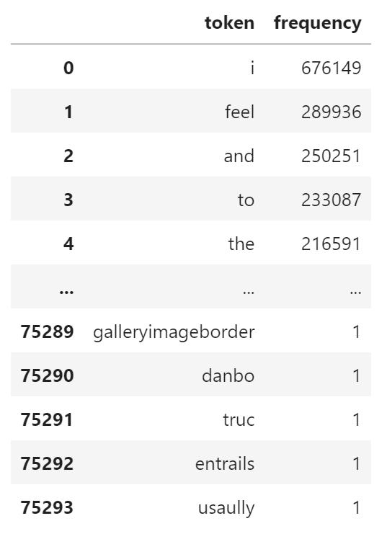
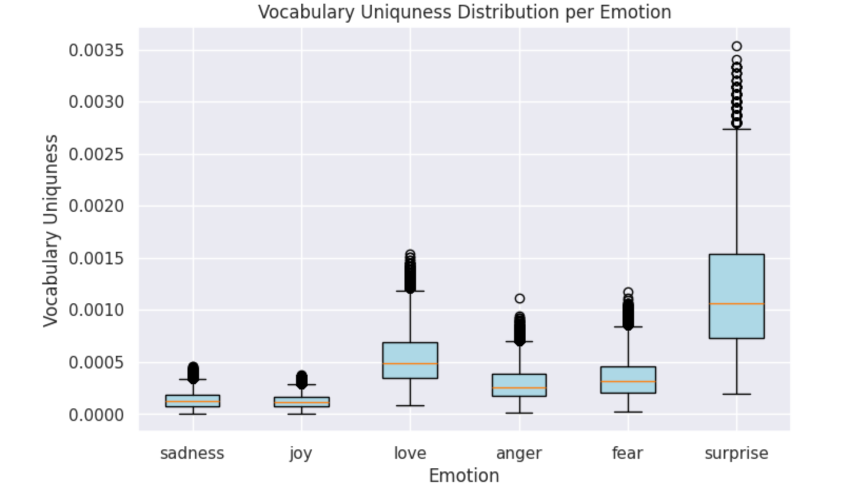
Data analyzing, preprocessing and feature extraction
Tokenizing

Slide 7
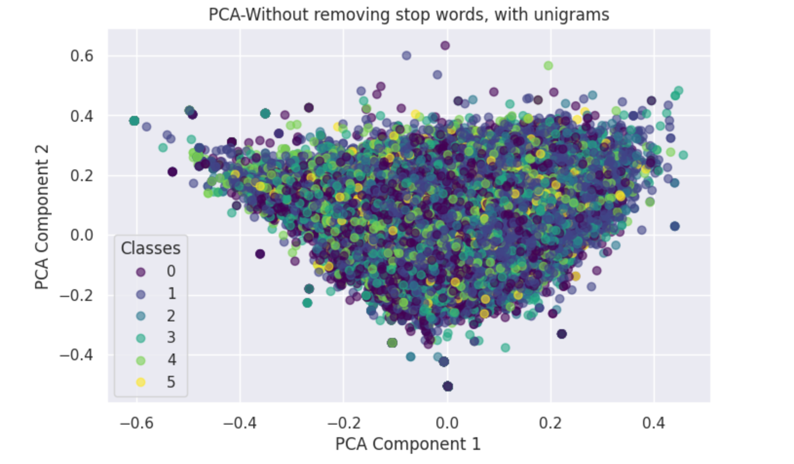
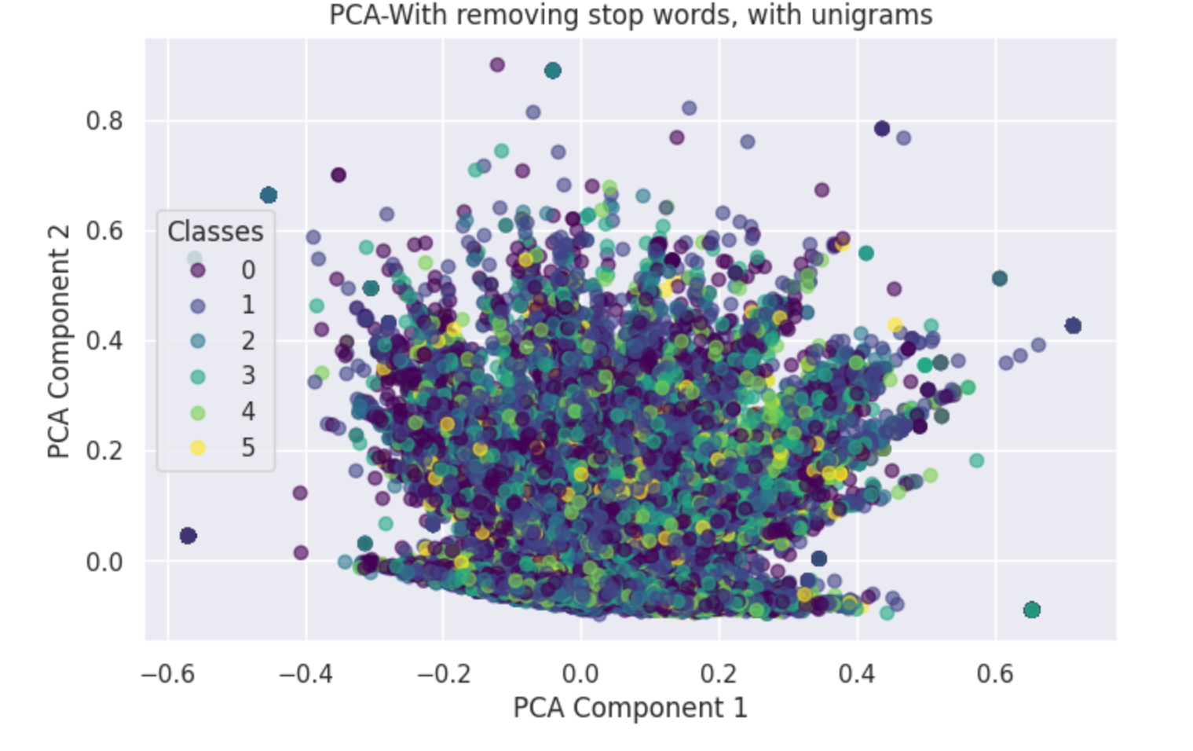
Vectorizing and visualization
TF-IDF
PCA

Slide 8
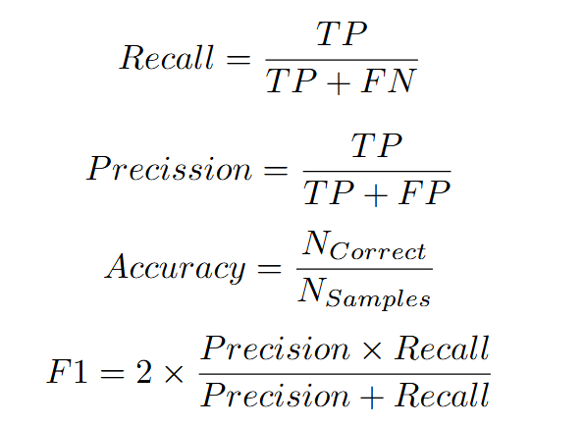
Model training and evaluation
Imbalanced classes
80% training set, 20% test set
80% training set, 20% validation set

Slide 9
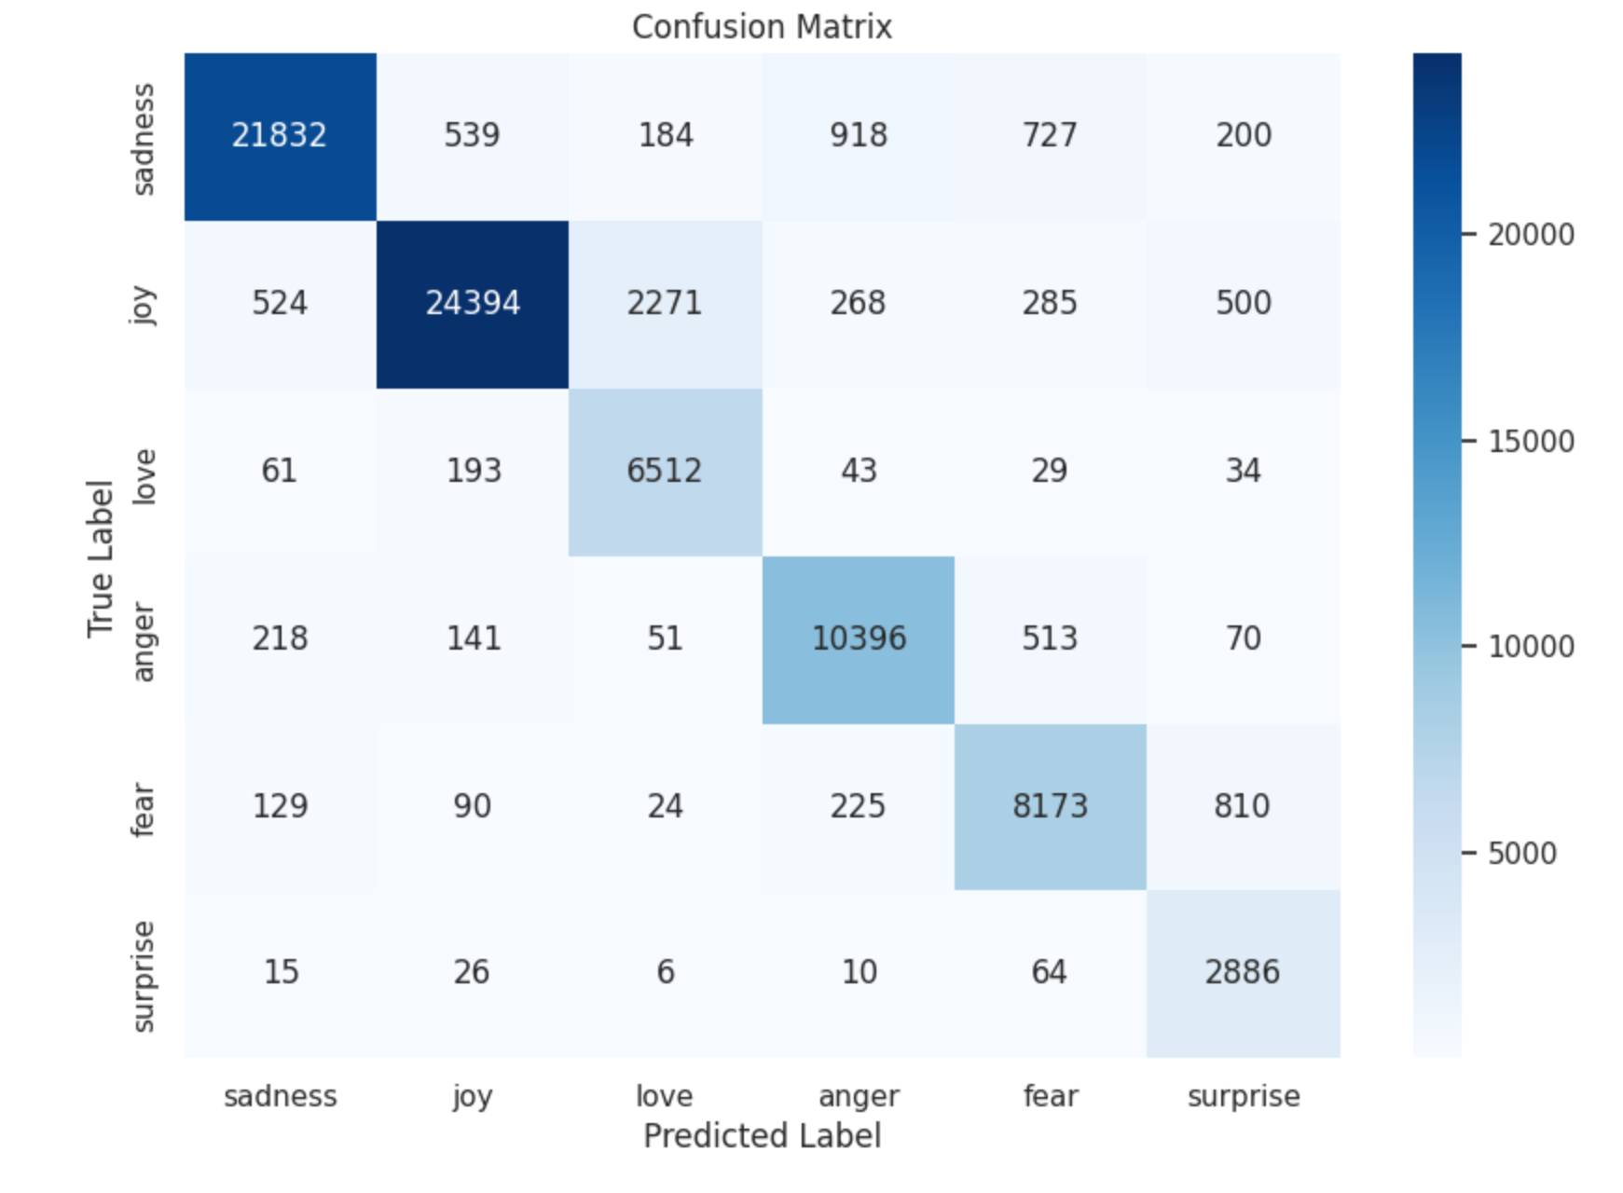
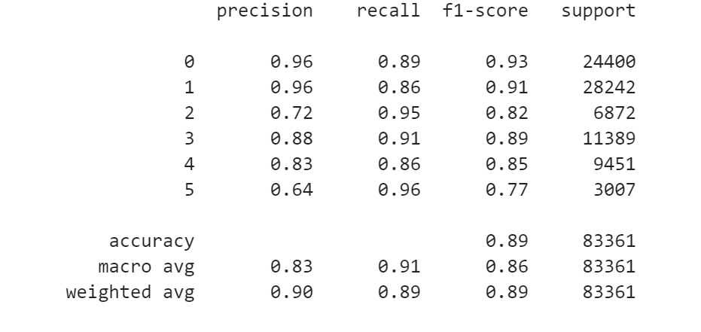
Convolutional Neural Network
4 convolutional layers, 3 max-pool layers, fully-connected layer
ReLU, Softmax
Dropout, EarlyStopping
Sparse Categorical Crossentropy, Adam optimizer
50 epochs, 32 batch-size

Slide 10
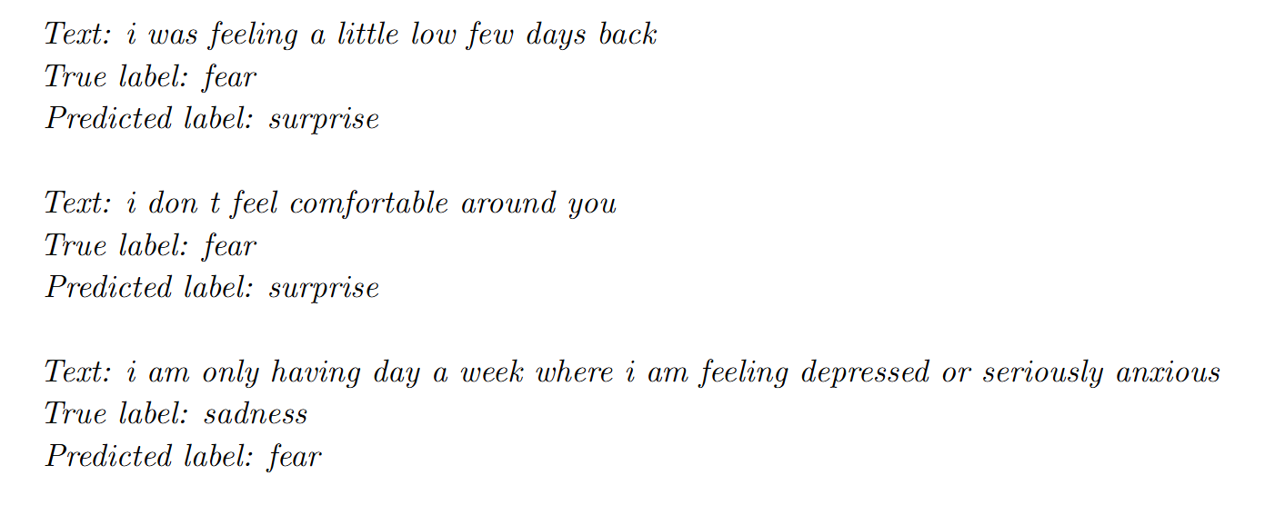
Convolutional Neural Network
Error analysis

Slide 11
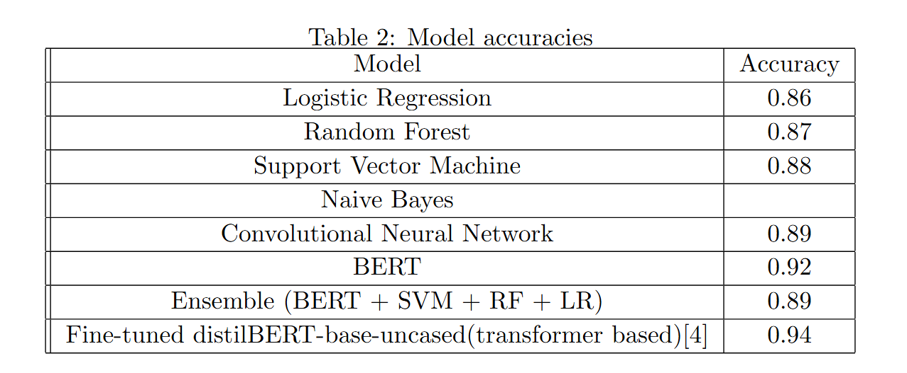
Results Comparison

Slide 12
Thank you for attention!

